Slide 1
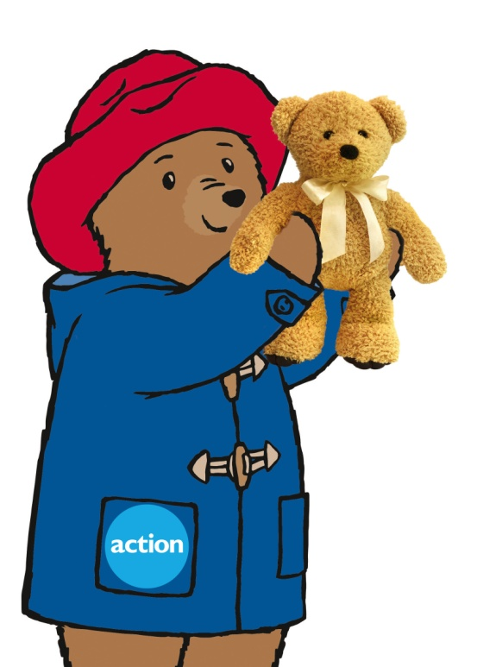
Fundraising is
fun with
Paddington Bear
TM

Slide 2
Supporting charities can be fun but why else should we do it?
Why do we help charities?
What is a charity?
Which charities do you know?
What kind of things do charities do?
Why do you think it is important
to support charities?
Notes:
There are lots of different types of charities.
Some help animals
Some help children
Some help adults and others help people in other countries.
Charities are there to help people that need help.
Charities often help animals that no longer have an owner, children and adults that are poorly, people that don’t have access to basic things like food, water or a home. They also help people in other countries that might have been affected by things like flooding.
(Optional – Some charities you might have heard of are: NSPCC, RSPCA, Comic Relief, Sport Relief, Help for Heroes, Children In Need, Oxfam)

Slide 3
Let’s learn all about
Action Medical Research
We’re a charity
We’ve been helping children for more than 70 years
We fund research to help:
babies born too early
children with disabilities
children with rare diseases

Slide 4
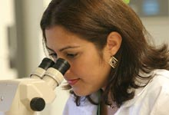
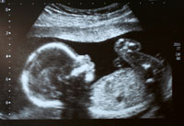
What is research?
Researchers work in places called laboratories.
Have you ever seen a
photo like this?
Researchers are like detectives. They try to solve mysteries that help us understand things like why babies are born early or sick. They try to find ways to make them better.
Our researchers discovered a way for parents to see their babies before they are born and for doctors to help make sure they are growing as they need to be, healthy and strong!

Slide 5
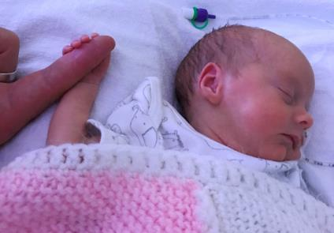
Born too soon
Have you ever helped to bake a cake? Just like cakes, babies need a certain amount of time to grow to just the right size. If they are born too soon they might need a little extra care.
Our researchers help by trying to find out why babies are born early and how we can help them grow up to be strong and healthy.
Maybe you, or your baby brother or sister, were born too early?
Notes:
Encourage the children to discuss what the differences might be when comparing a baby born too early and baby born healthy.

Slide 6
Disabling conditions
We are all different in some way, it is what makes us special.
Some children need a little help with certain conditions that make some things in life difficult
Have you heard of any of these disabling conditions?
Notes:
Help the children say the words and discuss if they have heard of them or know anyone that has them and why children with these conditions might need help.

Slide 7
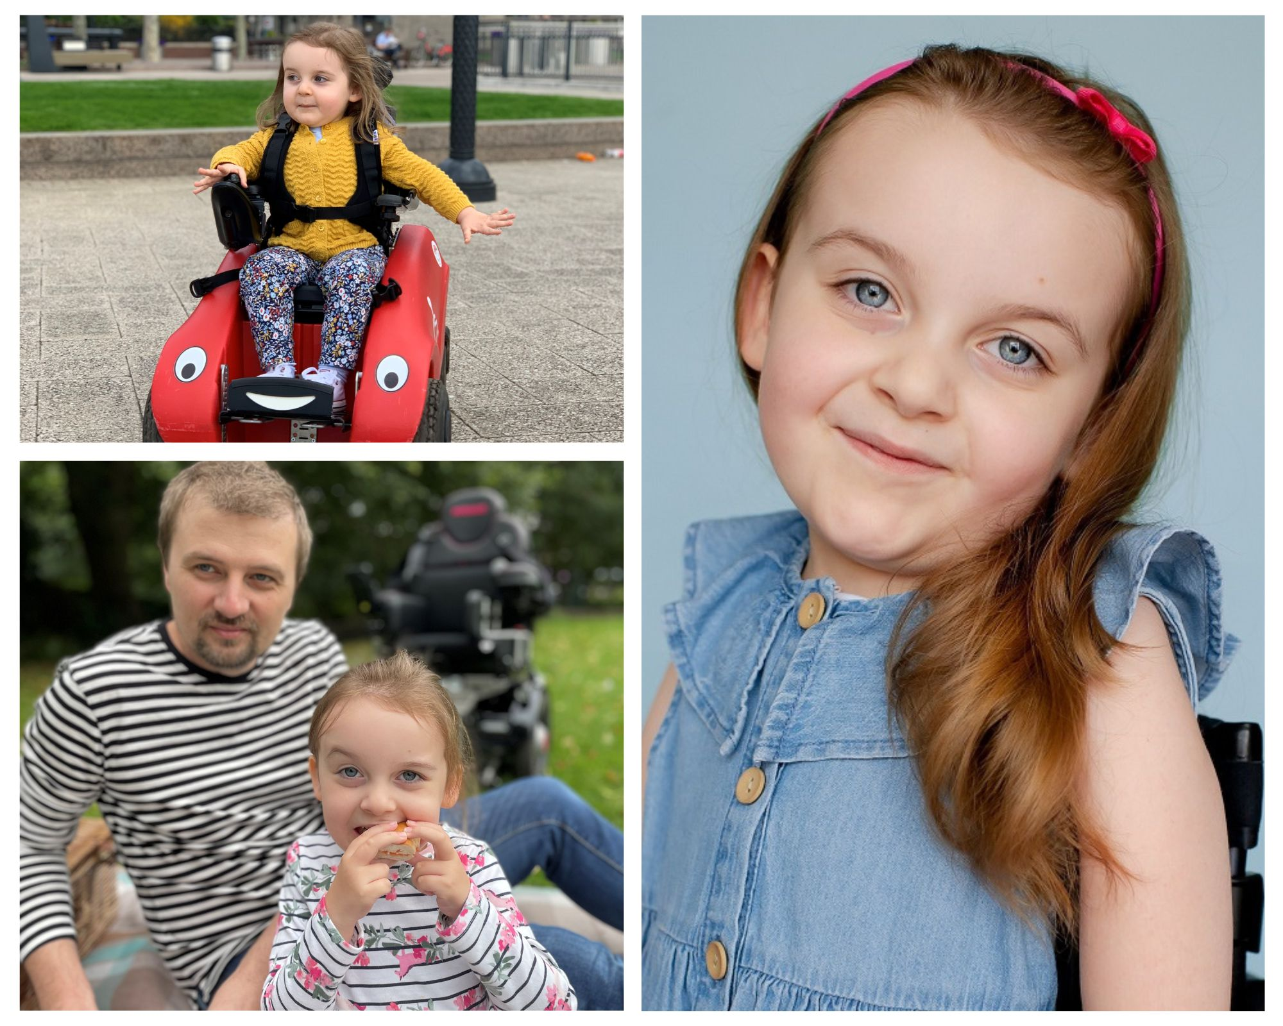
Rare diseases
This is
Sophia and she
has a rare disease called spinal muscular atrophy
Notes:
Everyone gets poorly, put your hand up if you can remember being poorly? Did you take some medicine that made you feel better?
Some children are very poorly with rare illnesses and at the moment there is no medicine that will make them better. We are helping scientists try to find a cure for these illnesses so that children in the future won’t be poorly.
Sophia’s dad says this is very important work.

Slide 8
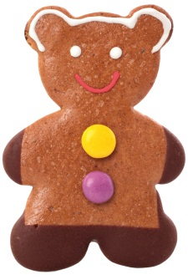
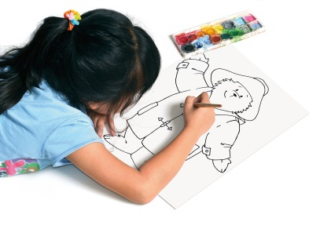
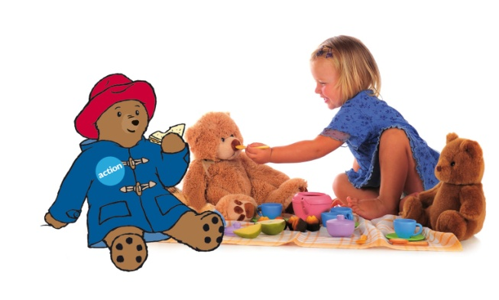
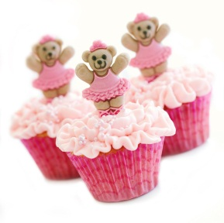
How you are helping
The money you raise by taking part in Bring your Bear will help save and change the lives of babies and children.
What have you got planned for your Bring your Bear event?

Slide 9
We hope you have a
great time with your bears. Don’t forget to email us at byb@action.org.uk and tell us all about what you
did!
P&Co Ltd/SC 2023
Licensed on behalf of Studiocanal S.A.S by Copyrights Group
© Action Medical Research 2023 Action Medical Research is a registered charity: England and Wales no. 208701; Scotland no. SC039284

